Slide 1
Robot learning update
Gene olafsen
Steve Aronson

Slide 2
Lessons learned
Noise
Defined here as variability in movement for the same state/action
Has a huge impact on learning
Reducing the state space size improves learning
For same time of learning (steps), more updates for each state/action
Magnitude of individual rewards is increased – improved signal/noise
Replacing last movement with a sample average can mitigate noise
Build a model of the robot using sample averages of returned movements

Slide 3
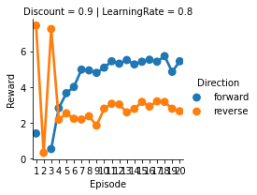
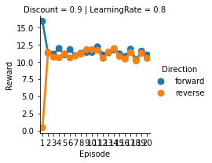
Using reduced State space to accelerate learning
Learning rate for 9x9 (SIM)
Learning rate for 3x3 (SIM)

Slide 4
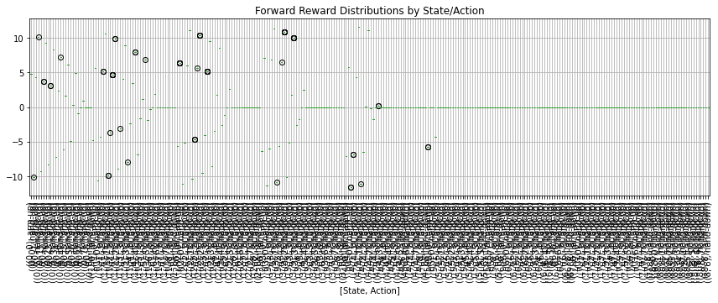
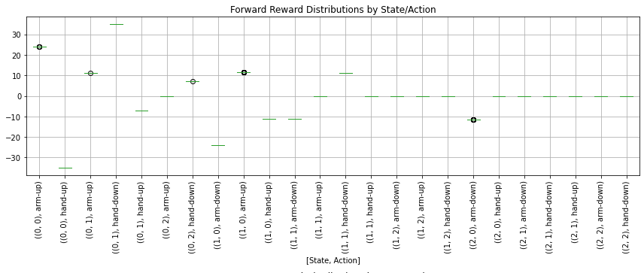
Rewards are concentrated into single actions
Movement for each state/action 9x9 (SIM)
Movement for each state/action 3x3 (SIM)

Slide 5
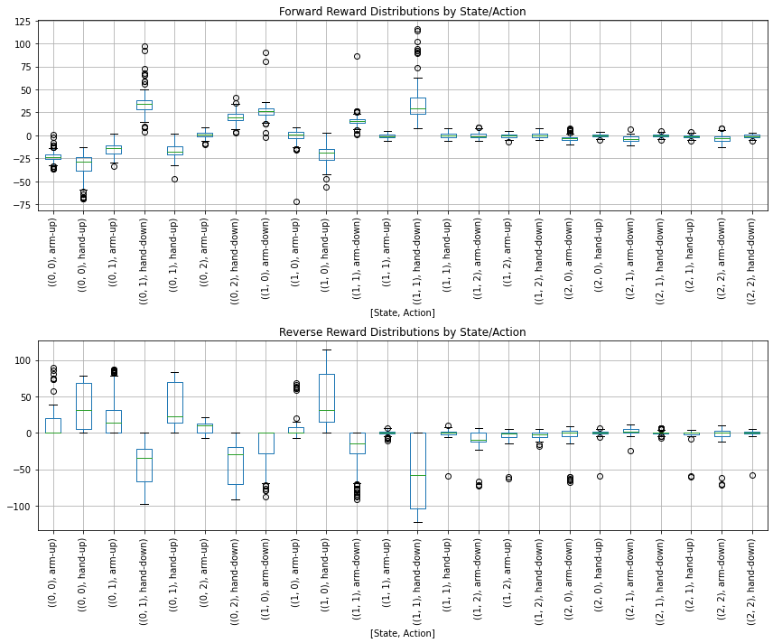
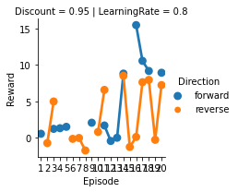
Robot learning – iteration 1
Robot 3x3

Slide 6
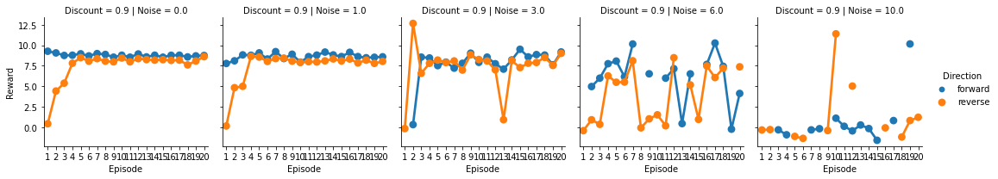
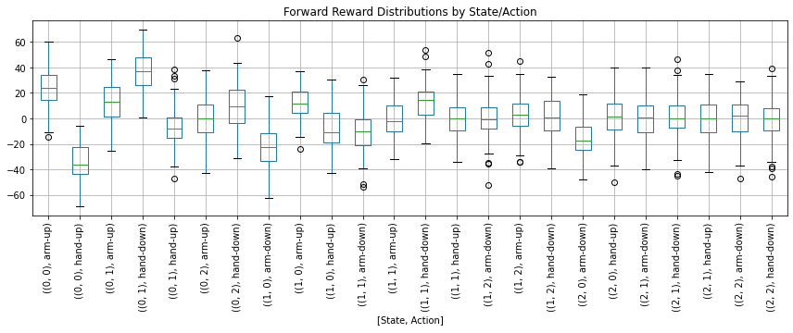
Impact of noise on learning
Increasing noise
Add noise to movement to emulate robot behavior

Slide 7
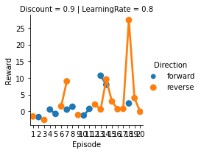
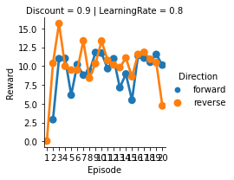
Reduce impact of noise by using sample averages
Reward = Last movement
(Sim)
Reward = sample average(movement)
(SIM)

Slide 8
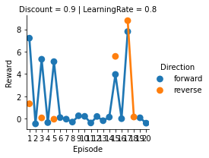
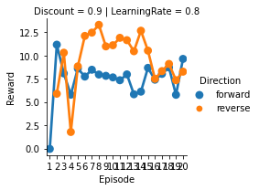
ROBOT 3X3
STANDARD Q-LEARNING
USING SAMPLE AVERAGE

